Slide 1
Economics of Demeny Voting
Reiko Aoki (CIS,IER, Hitotsubashi University)
“Political Economy of Low Fertility of Aging” Workshop
Center for Intergenerational Studies (CIS) & National Institute of Research Advancement (NIRA)
2 March 2011

Slide 2
Background
2 decades of low fertility crisis
Policies to increase fertility have not been effective
Political attention on other topics
Pension reform
Healthcare

Slide 3
Intergenerational allocation of resources
Traditionally a “family” or “regional (village)” policy
In 20th century, it is done by national governments, as public policy
Tax, social security tax
Pension, health care
Object of political debate and decision

Slide 4
Equivalent Income Before and After Redistribtuion
Income (10,000yen)
Source: 2008 Income Redistribution Survey, Ministry of Health, Labor and Welfare

Slide 5
Political Representation
Not all generations are represented in the political process
Currently people under 20 (18) have no representation
This is the case even as intergenerational redistribution becomes greater proportion of national budget

Slide 6
Political Representation of Generations
Source: “Population Projections for Japan,“ National Institute of
Population and Social Security Research

Slide 7
Political System and the Economic Environment (1)
Political system has evolved with the economic and social environment
One person one vote is a relatively new idea
Franchise expansion 19th century
Women’s suffrage 20th century

Slide 8
Political System and the Economic Environment (2)
Franchise expansion
Franchise extended in 1832, 1867, 1884 (Europe)
“Elite” gave rights to “poor” to prevent revolution (Acemoglu & Robinson 2000)
Emergence and concentration of working class in cities

Slide 9
Political System and the Economic Environment (3)
Women’s suffrage
1893 (New Zealand), 1920 (US), 1940 (Japan)
Men vote to empower women for children’s education (Doepke & Tertilt, 2009)
Importance of human capital investment with development of labor markets

Slide 10
Recent Changes in Economic Environment
Change in age structure
Significant part of Intergenerational distribution of resources is public
Need to account all generations in the political process
Danger of resource depletion requires consideration of future welfare

Slide 11
Demeny Voting
Have a parent or parents vote on children’s behalf
Example
Mother, father, and 1 child
Each parent has 1 (self) + 0.5 (1/2 of 1 child)=1.5
In practice, need to clarify cases of adopted children

Slide 12
Demeny Voting
 | Current | Demeny Voting
Parents | 24% | 37%
Pension Bloc ( >55 years) | 43% | 35%

Slide 13
Is Demeny Voting Beneficial to Current Voters ?
Can it be achieved through democratic process ?
Why would current voters ( 20years and older) give children a vote ?
All generations benefit from greater investment in children
Demeny voting prevents free riding among current generation = able to commit to future

Slide 14
Economics Model Framework (1)
Intergenerational Income Distribution using “OLG”
2 generations Working and Retired
Altruism
Parent cares about child (forward)
Child cares about parent (backward)
Retired with or without children
Working generation still reproducing

Slide 15
Framework (2)
Politically determined income distribution
Intergenerational coalition possible
Demeny voting system
Child has a vote
Parent votes on behalf
Why ?
Intergenerational income distribution has become a political issue. All generations should have political representation.

Slide 16
Main Conclusion
Working generation become more altruistic → Working generation + Retirees with child coalition → Lower fiscal burden of Working generation → Working generation better-off
Demeny voting cooperation possible with
Higher levels of intergenerational altruism
Weaker political power of working generation
Majority better off with Demeny voting

Slide 17
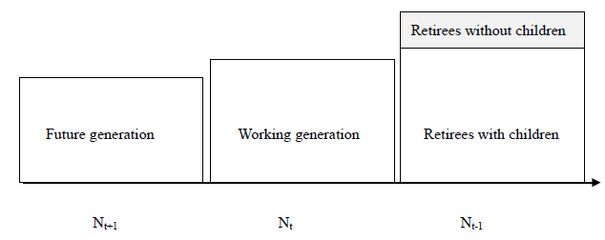
Generational Structure
Proportion with Child

Slide 18
Households (1)
There are two generations involved in each period t (t=0, 1, 2,…)
Working generation t
Retired generation t－1 (which was the Working generation in period t).

Slide 19
Households (2)
Working generation t , in period s, earns lifetime wage, , has lifetime consumption,
and pays tax in period . In period t,
Retired generation t-1, can recover tax paid in t-1 by issuing bonds in period t,

Slide 20
Household Utility
Retired generation t－1 with children
Retired generation t-1 without children
Working generation t
= Backward altruism
= Forward altruism

Slide 21
Government Budget Constraint
(Planned) tax on generation t+1 in period t
Public debt when population size is

Slide 22
Political Process
“Retirees with children Independent Majority Regime”
“Working generation Independent Majority Regime”
Generation k’s political activism in period t (e.g. voter turnout rate).

Slide 23
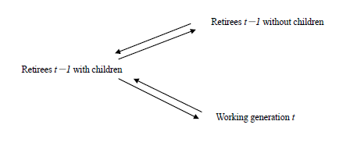
Possible Cooperation (Coalition)

Slide 24
Cooperation (Coalition) Regimes
“Retirees Cooperation Regime”
“Working generation + Retirees with children Cooperation Regime”
Relative political influence of the working generation compared to working generation t-1

Slide 25
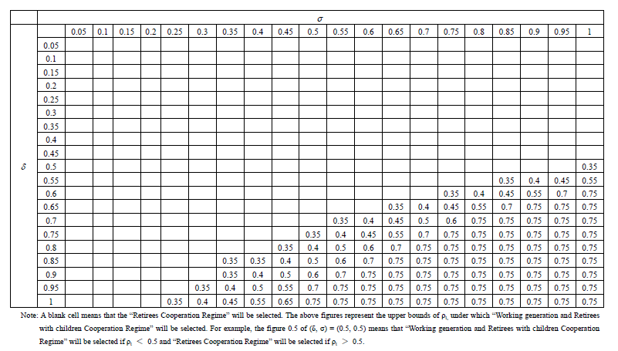
Upperbound for “Working generation + Retirees with children”
Backward altruism
Forward
altruism
= political influence of the working generation

Slide 26
σ increases →Tax rate declines and Working generation utility increases

Slide 27
Change of Regime
Care more about parents (more backward altruism)
Change from “Retirees Cooperating” to “Working generation + Retirees with children”
Tax burden lower and become better off

Slide 28
Demeny Voting
Children (all those currently below the voting age) given votes but parents vote on their behalf (Demeny 1986, Aoki and Vaithianathan 2009）
ξ : Extent of extension of voting rights to children (minimum voting age)

Slide 29
Effect of Demeny Voting
Current regime in Japan is “Retirees Cooperation Regime”
Demeny Voting implies “Working Generation + Retired Generation with children regime” is possible,

Slide 30
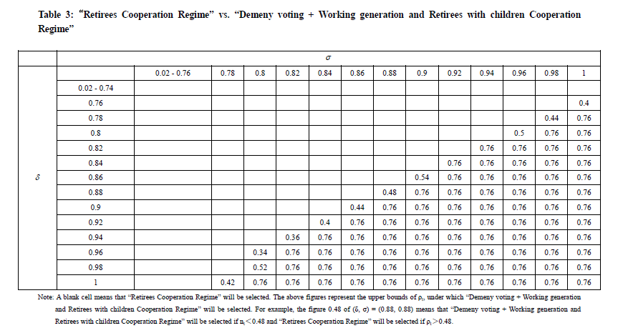
Backward altruism
Forward
altruism
Without Demeny voting, upperbound is 0.75 (Table 1)

Slide 31
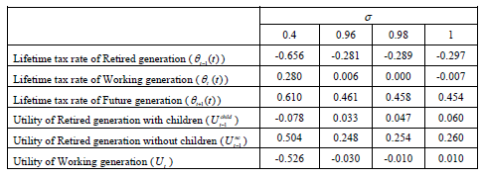
Working generation
better-off with
Demeny voting

Slide 32
Main Conclusion
Working generation become more altruistic → Working generation + Retirees with child coalition → Lower fiscal burden of Working generation → Working generation better-off
Demeny voting cooperation possible with
Higher levels of intergenerational altruism
Weaker political power of working generation
Majority better off with Demeny voting

Slide 33
References
Acemoglu & Robinson 2000.”Why Did the West Extend the Franchise? Democracy, Inequality, and Growth in Historical Perspective”, Quarterly Journal of Economics 115 :1167–1199
Aoki, R. and R.Vaithianathan, 2009. “Is Demeny Voting the Answer to Low Fertility in Japan?” CIS DP No. 435.
Demeny,P., 1986. “Pronatalist Policies in Low-Fertility Countries: Patterns, Performance and Prospects,” Population and Development Review, 12(Supplement):335-358.
Doepke&Tertilt, 2009. “Women’s Liberation: What’s in it for Men ?” Quarterly Journal of Economics 124:1541-1591
Oguro,K., M.Shimasawa, R.Aoki and T.Oshio, 2010 “Demographic Change, Intergenerational Altirusm Policy – A Political Economy Approach,” CIS DP No.493.
http://cis.ier.hit-u.ac.jp/English/

