Slide 1
Mother's Labor Force Participation in Early Childhood and the Child's Educational Attainment
Miki Kohara and SunYoun Lee
Osaka University
1. Purpose
Examine how maternal employment at the child’s age of three affects his/her educational outcome at age of eighteen, using Korean panel data.
2. Motivation
The long-run impact of family environment (maternal employment) on child’s development (educational outcome)?
Two opposite directed effects : maternal employment may increase money input but may decrease time input on child’s education => a total effect of maternal employment on child’s educational outcome is not decisive theoretically

Slide 2
Introduction
3. Main Result
Maternal employment at age three affects test scores at age eighteen, but the effect is opposite between high (minus effect) and low educational levels (plus effect)
This result is obtained, after (1) controlling for mother’s educational attainments, father’s occupations, and economic conditions, (2) allowing for the existence of unobserved heterogeneity in a child’s educational outcomes and the mother’s employment, and (3) allowing for non-linearity (heterogeneity) in the effects.
4. Originalities and Contributions
Consider endogeneity of maternal employment and heterogeneity of its effect
Show a long-term effect of maternal employment on the child’s development
Examine the Korean case

Slide 3
Introduction 2
5. Why Korea?
Important policy issue: there is a social concern about how parent’s (mother’s) behavior affects educational outcomes.
> Education obsession
> Extremely low married female labor supply
Good for the analysis: we can use test score data as educational outcomes
“CSAT” College Scholastic Ability Test; once a year at the same time all over the country
>Objective measure of educational outcomes
>Showing a degree of educational attainments
>Measuring outcomes at the end of high-school
*Many students take this exam: 82% of the students in the last year of high school (04)

Slide 4
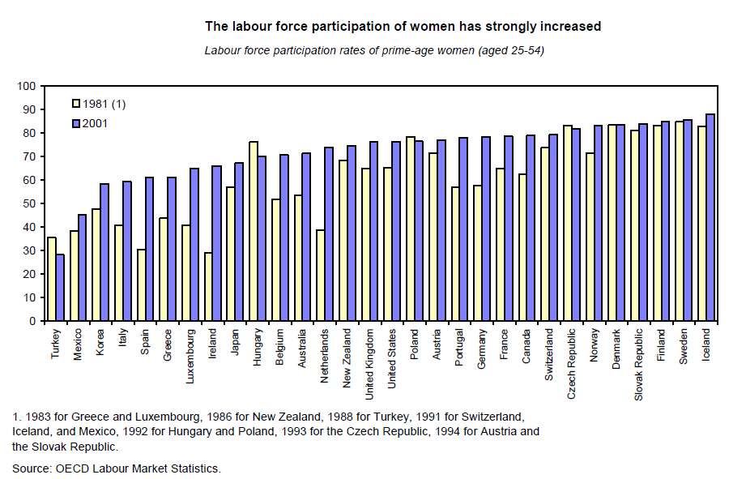
Labor Force Participation of Women (LPR)
2001
1981

Slide 5
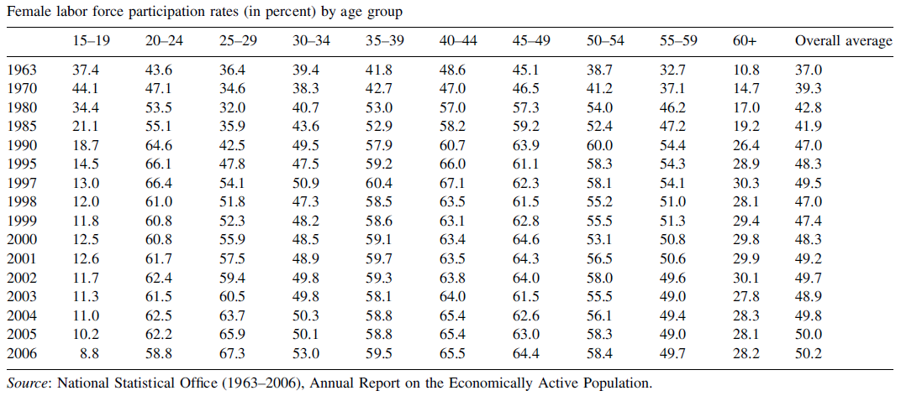
LPR of married women
LPR for the 25-29 age group were 7-27% points lower compared to those of other child bearing age groups of 20-24 and the 30-49
LPF for the age group 15-19 appears to have continuously declines since 1970.

Slide 6
Literature Review 1
6
Maternal employment deteriorates the child’s educational outcomes? -Ambiguous results. Not always.
 |  | The impact of maternal employment on child’s development
Baker, Gruber and Milligan (2008) | Canada | ―
Ruhm (2008) | USA | ― for high economic condition group, but No effect for lower groups
Bernal (2008) | USA | ― if a mother started working as a full time worker within a year after giving a birth No effect of temporary income change
Dustman and Schonberg (2008) | Germany | ― Policy change of prolonged maternal leave raises child’s educational outcomes
Tanaka and Yamamoto (2009) | Japan | No effect of maternal employment at the child’s age 0-3 * But maternal employment after that can lower the probability of going to (probably highly ranked) private or national junior high schools.

Slide 7
Literature Review 2
7
Literature on causation behind the effect
(1 )Maternal employment ⇒ more income & more investment on education ⇒ child’s educational attainments ↑ … Ambiguous results
(2) Maternal employment ⇒ less time with children ⇒ child’s educational attainments ↓ … Ambiguous results
NOTE: Maternal employment － full time worker / high-skilled labor = mother’s higher education level ⇒ child’s educational attainments↑ － part-time worker / low-skilled labor = mother’s lower education level ⇒ child’s educational attainments↓ ☝We need to control for mother’s educational attainment.
Maternal employment － weak preference for child’s care⇒child’s educational attainments↓ － strong preference for child’s care⇒child’s educational attainments ↑ ☝We need to remove a bias raised by unobserved heterogeneity.

Slide 8
Two difficulties in the estimation
Empirical Framework 1
Educational Outcomes at 18 years old
(2) Heterogeneous Effects
-Linear estimation with endogenous variables can be biased.
Estimation for different thresholds
Mother’s employment at age 3
Mother’s unobserved ability
＋／－ Over/Under estimate
Mother’s preference for child’s education
－／＋ Under/Over estimate
Environmental effect or peer effect of female labor supply at that time, but not to affect child’s educational outcome later at age of 18
(1) Problem of Endogeneity
-Estimations with categorical data or quantile regression can be insufficient.
Female Labor Force
Participation Rates

Slide 9
Non-linear simultaneous decisions
Empirical Framework 2
Ti is a dummy variable indicating 1 if a child’s test score is in a “higher” group
Mi is a dummy variable indicating 1 if his or her mother was working
Method: Probit Model with Endogenous Treatment
Data：Korean Labor & Income Panel Study（KLIPS)
Note.
Heterogeneous effect of maternal employment on child’s test score: the effect could be different among the levels of test-scores. → Conduct the estimation, changing the threshold!

Slide 10
Non-linear effect of maternal employment on child’s test score
Empirical Framework 3
Idea!
Rank 12
Rank 11
Rank 10
Rank 9
Rank 8
Rank 7
=1 (if test score rank>=7)
=0 (if test score rank<7)
=1 (if test score==7)
otherwise 0 (if test score≠7)
Rank 1

Slide 11
Data 1
Korean Labor and Income Panel Study；KLIPS(1998-2008), conducted by the Korea Labor Institute, a government-sponsored research organization.
  Household Survey：Householder or spouse （nationally representative sample of 5,000 households）
  Individual Survey：Each person in the household aged 15 and over（approx.12,000 persons)
  Additional Survey（2001～2008）：yearly special modules for restricted sample, such as the youth, the old or the employed.（approx.4500 persons）
  Survey method：Household Interview
Data used for this study
  Additional Survey (2006): contains detailed information on education-related records of the youth aged 15 to 35 at the time of survey(4,389 persons)
    Maternal employment
  Individual and Household Surveys (1998-2006): individual characteristics
    Individual (2002): Test score for the College Scholastic Ability Test (CSAT)
    Individual (1998-2006): Parental and child’s educational attainment, birth year and place to grow up, socio-economic status at age 14, father’s occupation at age 14
    Household (1998-2006): demographic information: family composition, marital status
11

Slide 12
Important variables: (1) Educational Outcomes at age 18
Data 2
Test score for the university entrance exam (CSAT)
Historical changes in university entrance examination test
1981-1993: Achievement Test started (Highest = 340)
1994-1996: College Scholastic Ability Test 1 started (Highest = 200)
1997- : CSAT 2 started (Highest = 400)
2002- : Diversification of entrance exam. : University can use other types of exams.
Our sample took either (1), (2) or (3).
Test scores are answered as 12 ranks
We need to control for the difficulties in each year.
Advantages of this indicator
Achievement test and college scholastic ability test were the most important single determinant for the university admissions in Korea.
Most of Korean high school students with the same academic attainment take the same test on the same day (advancement rate to university: 82%, test takers were 572,218 and third grade of high school students 582,216 in 2004)
Because the answers are formatted in score ranges with the interval of 10 to 40 scores, potential measurement errors may be small.
12

Slide 13
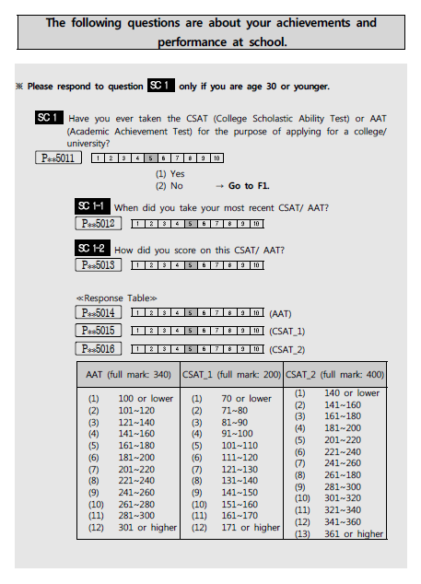
KLIPS answer sheet
Data 3
13

Slide 14
Data 4
Father’s occupation
= 1 if a father works in
agricultural industry

Slide 15
Data 5
Notes:
Average test scores are controlled for in several ways.
- dependent variable: “respondent’s own score－average test score”
whether this difference is positive or not / more than 30 or less than 30 / ….
- controlling for year dummies and/or average test score
LPR of women when our sample was 2 to 5 years old（%）
  Source: National Statistical Office, Annual Report on the Economically Active Population Survey
  Economically Active Population: The employed and those are who are currently looking for a job
  LPR: (Economically Active Population/labor force aged 15 and over)＊100
    1） By age range
    Imputed from i) mother’s age when the child was 3 years old and ii) LPR of women in Korea at the time at the child’s age 3 => LPR by age range of mothers at child’s age 3
    2) By educational level
    Imputed from i) mother’s educational attainment ii) LPR of women in Korea at the time at the child’s age 3 3 => LPR by educational attainment of mothers at child’s age 3
Test score ranks, 7 and 10 are focused.
15

Slide 16
Estimation Results 1
Dependent variable:
12 test score ranks
Considering endogeneity but not heterogeneity in the effect
(linear IV)

Slide 17
Estimation Results 2
Dependent variable:
Probability of being classified to each test score rank (12 ranks)
Considering heterogeneity in the effect but not endogeneity
(ordered probit)

Slide 18
Estimation Results 3
Dependent variable:
Probability of being classified to each test score rank (3 ranks)
Considering heterogeneity in the effect but not endogeneity (ordered probit)
Rank 1= test ranks 1-4
2= 7-9
3= 10-12

Slide 19
Estimation Results 4
Dependent variable:
12 test score ranks
Considering heterogeneous effects but not endogeneity
(quantile regression)
These results suggest:
We cannot find a robust unambiguous effect of maternal employment: either positive, negative, insignificant???
The effect of maternal employment may be heterogeneous: positive in lower groups, and negative in higher groups

Slide 20
Estimation Results 5
Probit with endogenous decisions
Considering endogeneity and heterogeneous effects
Pr(M=1)
Pr(M=1)
Dependent variable:
Pr(T*≧10)
Higher threshold
Dependent variable:
Pr(T*≧7)
Lower threshold
Controlling for ave test scores

Slide 21
Estimation Results 6
Probit with endogenous decisions
Dependent variable: Pr(T*>=μ)
Higher threshold
Lower threshold
Controlling for ave test scores

Slide 22
Estimation Results 7
Probit with endogenous decisions
Dependent variable: Pr(T*>=μ)
Higher threshold
Lower threshold
Controlling for test years

Slide 23
Estimation Results 8
Probit with endogenous decisions
Dependent variable: Pr(T*－AveT*>=μ)
Higher threshold
Lower threshold
= 1 if a father works in agricultural industry

Slide 24
Estimation Results 9
Summary of the results
Maternal employment at age 3 lowers the probability that a child is ranked in higher than or equal to 10 (whether or not a child can go to so-called good universities)
Maternal employment at age 3 raises the probability that a child is ranked in higher than or equal to 7 (whether or not a child can go to universities or colleges)
Unobservables are controlled for by a simultaneous estimation mechanism.
Parent’s education, occupation, and economic conditions are also controlled for.
We attempted the other splits based on parent’s educational levels, occupation, and economic conditions, but we could not find any difference between the groups.
Maternal employment deteriorates the child’s educational outcomes for students in high ranks. But maternal employment raises the child’s educational outcomes for students in low ranks.

Slide 25
Estimation Results 10
Why opposite effects?
Maternal employment may decrease an interaction time with children, which discourages test score for children in high test-score groups. This deteriorating effect may be offset by the positive effect of money inputs increased by maternal employment in low test-score groups.
Maternal employment → Child’s education
High-ranked groups: time (-) >>> money (+)
Low-ranked groups: time (-) <<< money (+)

Slide 26
Conclusion
Results and Implications
Maternal employment at age three affects test scores at age eighteen, but the effect is opposite between high (minus effect) and low educational levels (plus effect)
Explanation other than parent’s education, occupation and economic conditions should be given.
One possibility is that maternal employment may decrease an interaction time with children, which discourages test score for children in high test-score groups. This deteriorating effect may be offset by the positive effect of money inputs increased by maternal employment in low test-score groups.
1. Not only discouraging effect but also encouraging effect of maternal employment on child’s educational attainments is found at least for those who were born between 80s & 90s in Korea.
2. We need to consider both endogeneity of maternal employment and heterogeneity in its effect when discussing maternal effect on the child’s educational outcomes.

Slide 27
c.f.

