Slide 1
Fewer School-days, More Inequality
Daiji Kawaguchi
Hitotsubashi University, RIETI, TCER, and IZA
Workshop on Intergenerational Transfers and other Intergenerational Issues
@Keio University
March 3, 2013

Slide 2
Intensity of Compulsory Education and Intergenerational Dependence of Educational Attainment
2 or 3 more Saturdays in a month are added as holidays in 2002 in Japan.
The regression coefficient of a child’s study time on parental education becomes 80% steeper.
The regression coefficient of a child’s academic performance on parental education becomes 20-30% steeper.

Slide 3
Compulsory Education as Leveling Institution
Compulsory education aims at assuring equal educational opportunities for every children.
Extended compulsory education reduces intergenerational dependence of educational attainment - Meghir and Palme (2005), Aakvik, Salvanes, and Vaage (2010), Brunello et.al. (2012)
Test score gap by socioeconomic status tends to increase after summer breaks -Downey, von Hippel and Broh (2004) and Alexander, Entwisle and Olson (2007).
`Incarceration effect’ of school education – Less crime (Jacob and Lefgren (2003)) and less teen age pregnancy (Black et al. (2008)).

Slide 4
School-day reduction in Japan
Primary school (1st – 6th grade) and junior high school (7th - 9th grade) are compulsory education.
Historically, schools gave a half day classes on every Saturday.
The revision of labor standard act in 1988 reduced hours worked per week. Saturdays and Sundays became holidays in most work places until 1994.
Second Saturday off from September 1992
Second + fourth Saturday off from April 1995
(5,785 class units for primary school, 3,150 class units for junior high school.)
All Saturdays off from April 2002
(5,367 class units for primary school, 2,940 class units for junior high school.)

Slide 5
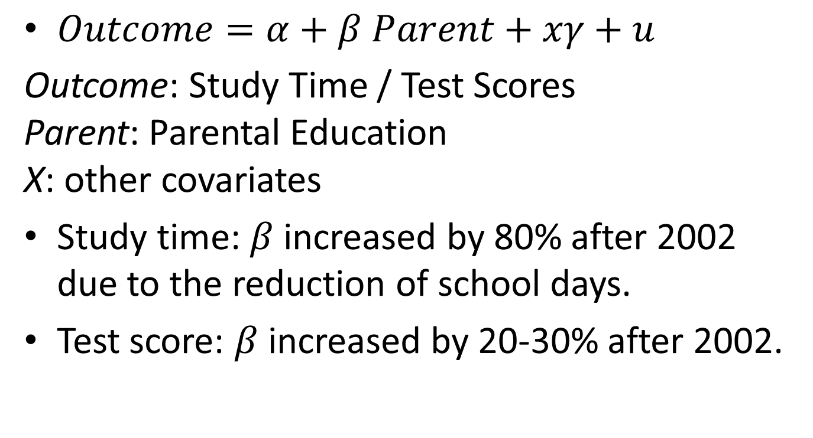
Hypothesis and Results
$Outcome=α+β Parent+xγ+u$
Outcome: Study Time / Test Scores
Parent: Parental Education
X: other covariates
Study time: $β$ increased by 80% after 2002 due to the reduction of school days.
Test score: $β$ increased by 20-30% after 2002.

Slide 6
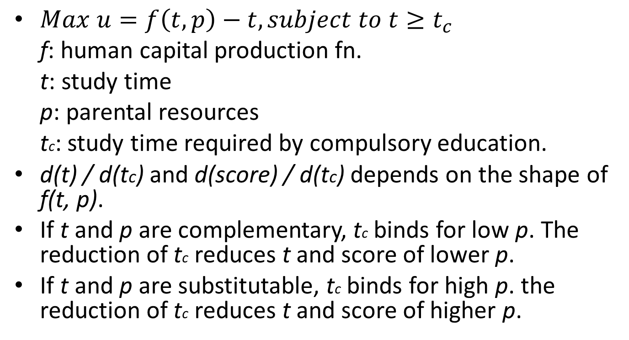
Compulsory Education, Family Backgrounds, Student Time Use and Academic Performance
$Max u=f\left(t, p\right)−t, subject to t≥t_{c}$
f: human capital production fn.
t: study time
p: parental resources
tc: study time required by compulsory education.
d(t) / d(tc) and d(score) / d(tc) depends on the shape of f(t, p).
If t and p are complementary, tc binds for low p. The reduction of tc reduces t and score of lower p.
If t and p are substitutable, tc binds for high p. the reduction of tc reduces t and score of higher p.

Slide 7
Japanese Time Use Survey
(JTUS, 社会生活基本調査)
A survey implemented by Bureau of Statistics of Ministry of Internal Affairs and Communications in every 5 years from 1976.
Use 1996, 2001 and 2006 waves.
Covers about 200,000 individuals of age 10 and over from 80,000 households.
Each individual fills time diary of 15 minutes intervals with 20 pre-coded activities for 2 consecutive days. Covers 9 days from 2nd Saturday to 3rd Sunday of October.
Sample – 9th Graders with parental information.

Slide 8
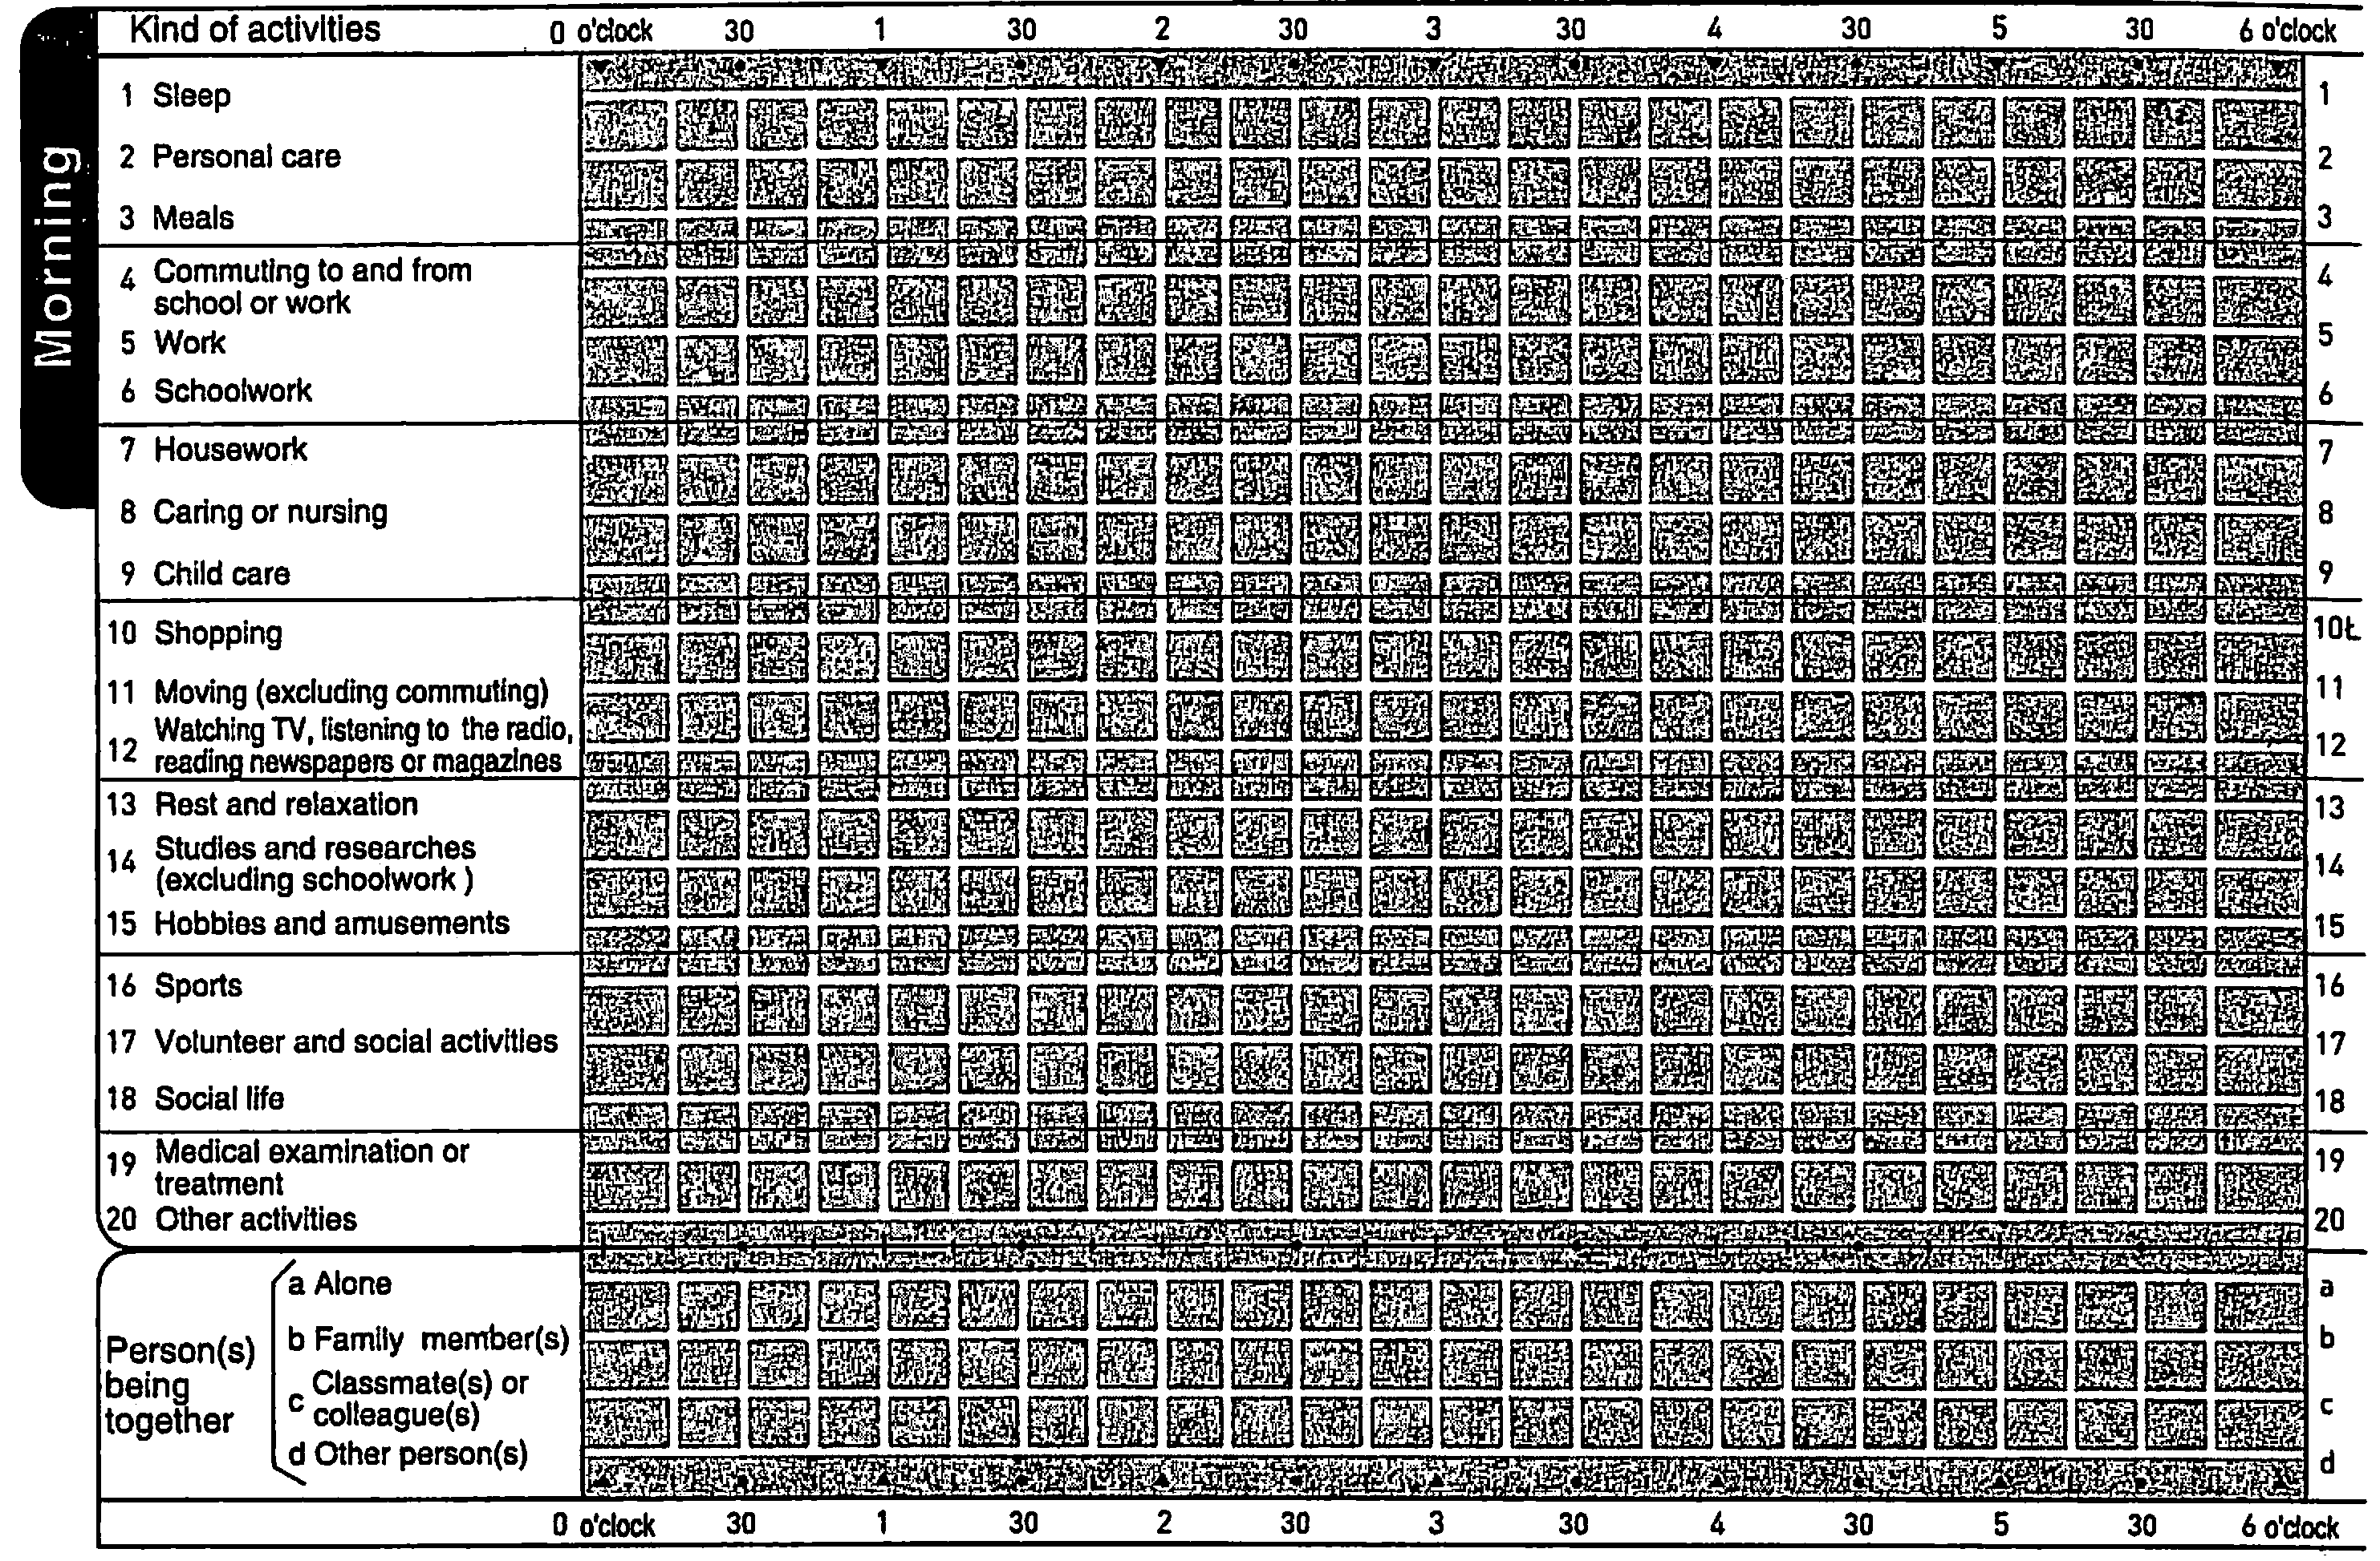
Pre-coded Time Diary

Slide 9
Classification of Time Use
Study includes commute, study, and research.
Leisure includes shopping, moving, watching TV and listening to the radio, hobbies, sports, social activities, and associations.
Other activities includes sleeping, personal care, eating, working, housekeeping, nursing, child rearing, rest, medical care, and “other activities”.

Slide 10
Sample Characteristics of 9th Graders
 | 1996 | 2001 | 2006
Study (Minutes per Day) | 434 | 463 | 458
Weekdays | 517 | 540 | 556
Saturday | 297 | 366 | 242
Sunday | 148 | 190 | 192
Leisure (Minutes per Day) | 254 | 228 | 220
Weekdays | 196 | 174 | 156
Saturday | 371 | 310 | 374
Sunday | 435 | 403 | 388
Other activities (Minutes per Day) | 752 | 750 | 761
Weekdays | 728 | 726 | 728
Saturday | 771 | 763 | 825
Sunday | 856 | 847 | 860
Girl (%) | 49 | 50 | 50
Head Education=9 (%) | 24 | 16 | 14
Head Education=12 (%) | 47 | 45 | 46
Head Education=14 (%) | 5 | 8 | 10
Head Education=16 (%) | 24 | 31 | 31
Female Headed (%) | 10 | 11 | 15
Single Parenthood (%) | 14 | 13 | 20
Mother's Employment (%) | 28 | 29 | 25
Annual Income -39 (%) | 18 | 20 | 25
Annual Income 40-59 (%) | 23 | 21 | 22
Annual Income 60-89 (%) | 33 | 32 | 32
Annual Income 90- (%) | 25 | 25 | 18
Observations | 7,645 | 4,852 | 4,140

Slide 11
Changes of Study Time, 9th Graders

Slide 12
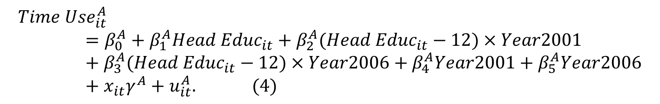
Change of Socioeconomic Gradient of Time Use
$${Time Use}_{it}^{A}=β_{0}^{A}+β_{1}^{A}{Head Educ}_{it}+β_{2}^{A}({Head Educ}_{it}−12)×Year2001+β_{3}^{A}({Head Educ}_{it}−12)×Year2006+β_{4}^{A}Year2001+β_{5}^{A}Year2006+x_{it}γ^{A}+u_{it}^{A}. (4)$$
xit: dummy variables for girl, female-headed household, single parenthood, mother’s employment, and 3 household annual income categories (4-5.99, 6-8.99, 9- million yen).

Slide 13
Changes of Child's Study Time by Head's Educational Attainment Before and After All Saturdays Became School Holidays in 2002,
9th Graders, Minutes Per Day
 | (1) | (2) | (3) | (4)
 | Mon-Fri | Sat | Sun | Daily Mean
Head Education | 5.80 | 6.63 | 4.84 | 5.34
 | (2.18) | (2.38) | (2.38) | (1.90)
(Head Education -12) ×2001 | -1.42 | -0.44 | 5.63 | 1.39
 | (3.59) | (3.58) | (3.61) | (3.08)
(Head Education -12) ×2006 | 1.41 | 9.85 | 8.31 | 7.00
 | (4.06) | (5.04) | (3.82) | (3.53)
2001 | 21.44 | 67.28 | 34.78 | 24.24
 | (7.85) | (9.04) | (8.42) | (7.33)
2006 | 35.74 | -60.09 | 37.87 | 16.05
 | (8.67) | (12.87) | (8.81) | (8.31)
Observations | 0.03 | 0.09 | 0.05 | 0.02
R-squared | 6,226 | 5,231 | 5,180 | 16,637
Socioeconomic gradient: 6.67 in 2001 -> 12.17 in 2006 (106% increase)

Slide 14
Changes of Child’s Study Time on Saturday among 9th Graders, 2001 and 2006, 3rd Saturday Becomes Holiday from 2002
 | (1) | (2) | (3) | (4)
 | 2nd Saturday | 3rd Saturday | 2nd Saturday | 3rd Saturday
Head Education | 12.39 | 0.24 | 11.17 | 0.44
 | (5.20) | (3.01) | (4.59) | (2.95)
(Head Education -12) × 2006 | 1.38 | 16.65 | -1.28 | 17.45
 | (7.70) | (6.65) | (6.65) | (5.28)
2006 | -38.60 | -185.07 | - | -
 | (22.75) | (13.65)
Prefecture × Year Fixed Effects | No | No | Yes | Yes
R² | 0.06 | 0.21 | 0.72 | 0.78
N | 1,119 | 1,725 | 1,119 | 1,725

Slide 15
Changes of Child's Time Use by Head's Educational Attainment Before and After All Saturdays Became School Holidays in 2002, 9th Graders, Minutes Per Day
 | (1) | (2)
 | Leisure | Other activities
Head Education | -4.26 | -1.09
 | (1.60) | (1.35)
(H Education -12) × 2001 | -3.11 | 1.72
 | (2.44) | (2.07)
(H Education -12) × 2006 | -7.30 | 0.30
 | (2.56) | (2.70)
2001 | -20.91 | -3.33
 | (5.99) | (5.04)
2006 | -24.73 | 8.67
 | (6.69) | (5.69)
R² | 0.03 | 0.00
N | 16,637 | 16,637

Slide 16
Changes of Child's Time Use, Minutes Per Day, Daily Mean, Prefecture × Year Fixed Effects Included, 9th Graders
 | (1) | (2) | (3)
Activity | Study | Leisure | Other activities
Head Education | 5.78 | -4.46 | -1.32
 | (1.84) | (1.59) | (1.38)
(Head Education -12) ×2001 | 1.60 | -2.75 | 1.15
 | (2.99) | (2.40) | (2.13)
(Head Education -12) ×2006 | 7.13 | -7.31 | 0.18
 | (3.39) | (2.61) | (2.58)
R² | 0.80 | 0.62 | 0.96
N | 16,637 | 16,637 | 16,637

Slide 17
Analysis of TIMSS and PISA
Trends in Mathematics and Science Studies (TIMSS), 1999 and 2003 waves, 150 schools, about 4000 8th graders took mathematics and science examinations, each lasting 90 minutes. Student survey includes the number of books at home and the possessions of computer and other items at home. It also includes parental highest educational attainment in 2003 wave.
The 2000 and 2003 waves of OECD Programme for International Student Assessment (PISA), about 5,000 10th graders from 140 schools. Reading, mathematics and science.

Slide 18
Test Scores, TIMSS and PISA
 | TIMSS 8th Graders |  | PISA 10th Graders
 | 1999 | 2003 | 2000 | 2003
Standardized math score | 50.2 | 50.7 | 49.6 | 50.1
Parent 4-year-college graduate | - | 53.7 | - | 51.9
Parent junior-college graduate | - | 50.1 | - | 47.8
Parent high-school graduate | - | 47.6 | - | 47.4
Parent junior-high-school graduate | - | 43.6 | - | 45.9
Standardized science score | 50.2 | 50.7 | 49.6 | 50.1
Parent 4-year-college graduate | - | 53.2 | - | 51.9
Parent junior-college-graduate | - | 50.5 | - | 47.7
Parent high-school-graduate | - | 47.9 | - | 48.1
Parent junior-high-school graduate | - | 45.8 | - | 44.8
N | 4,542 | 3,429 | 4,505 | 4,641

Slide 19
8th and 10th Graders Backgrounds,
TIMSS and PISA
 | 1999 | 2003 |  | 2000 | 2003
Girl (%) | 49.6 | 51.9
# of books at home (%)
0-10 | 13.8 | 12.2 | 1-10 | 11.2 | 9.9
11-25 | 19.3 | 21.2 | 11-50 | 25.2 | 11.8
26-100 | 31.2 | 32.1 | 51-100 | 19.9 | 32.6
101-200 | 18.1 | 16.8 | 101-250 | 22.4 | 18.5
200- | 17.5 | 17.6 | 251-500 | 12.3 | 17.4
 |  |  | 501- | 8.9 | 9.7
N | 4,542 | 3,429 |  | 4,505 | 4,641

Slide 20
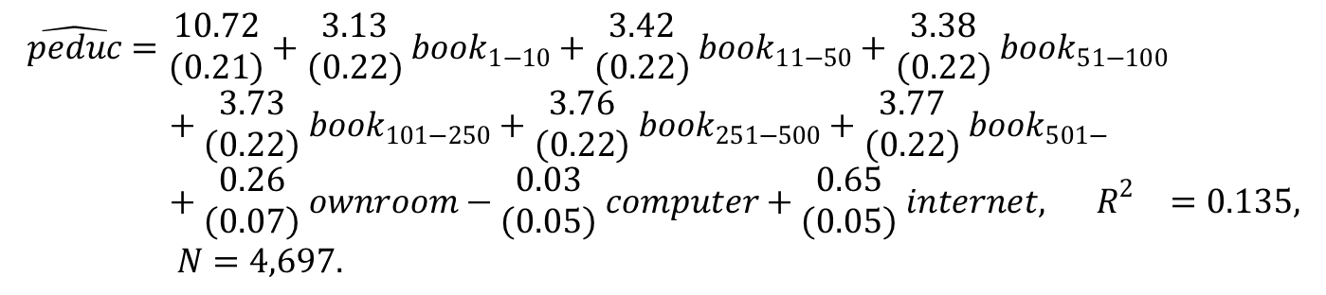
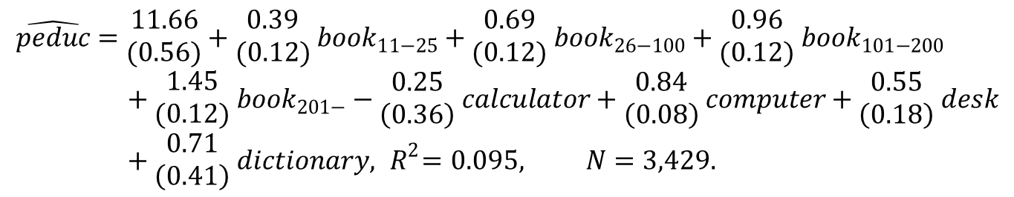
Predicting Parental Education
Based on 2003 Wave
$$\hat{peduc}=\begin{matrix}11.66 \\ (0.56)\end{matrix}+\begin{matrix}0.39 \\ (0.12)\end{matrix} {book}_{11−25}+\begin{matrix}0.69 \\ (0.12)\end{matrix} {book}_{26−100}+\begin{matrix}0.96 \\ (0.12)\end{matrix} {book}_{101−200}+\begin{matrix}1.45 \\ (0.12)\end{matrix} {book}_{201−}−\begin{matrix}0.25 \\ \left(0.36\right)\end{matrix} calculator+\begin{matrix}0.84 \\ \left(0.08\right)\end{matrix} computer+\begin{matrix}0.55 \\ \left(0.18\right)\end{matrix} desk+\begin{matrix}0.71 \\ \left(0.41\right)\end{matrix} dictionary, { R}^{2}=0.095, N=3,429.$$
$$\hat{peduc}=\begin{matrix}10.72 \\ \left(0.21\right)\end{matrix}+\begin{matrix}3.13 \\ \left(0.22\right)\end{matrix} {book}_{1−10}+\begin{matrix}3.42 \\ \left(0.22\right)\end{matrix} {book}_{11−50}+\begin{matrix}3.38 \\ \left(0.22\right)\end{matrix} {book}_{51−100}+\begin{matrix}3.73 \\ \left(0.22\right)\end{matrix} {book}_{101−250}+\begin{matrix}3.76 \\ \left(0.22\right)\end{matrix} {book}_{251−500}+\begin{matrix}3.77 \\ \left(0.22\right)\end{matrix} {book}_{501−}+\begin{matrix}0.26 \\ \left(0.07\right)\end{matrix} ownroom−\begin{matrix}0.03 \\ \left(0.05\right)\end{matrix} computer+\begin{matrix}0.65 \\ \left(0.05\right)\end{matrix} internet, { R}^{2}=0.135, N=4,697.$$
Assign predicted head’s years of education, $\hat{\hat{peduc}}$, based on the percentiles of predicted value, $\hat{peduc}$.

Slide 21
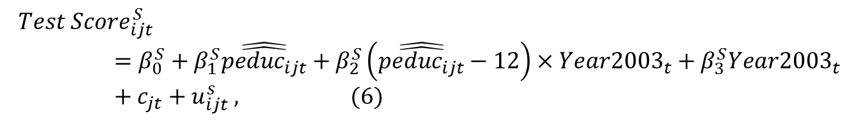
Change of Socioeconomic Gradient of Test Score
$${Test Score}_{ijt}^{S}=β_{0}^{S}+β_{1}^{S}\hat{\hat{{peduc}_{ijt}}}+β_{2}^{S}\left(\hat{\hat{{peduc}_{ijt}}}−12\right)×{Year2003}_{t}+β_{3}^{S}{Year2003}_{t}+c_{jt}+u_{ijt}^{s} , (6)$$
Standard errors are bootstrapped by 500 repetitions.
An alternative specification: Allowing for school-year fixed effects.

Slide 22
Socioeconomic Gradient of Test Scores in 1999 and 2003, 8th Graders, Standardized Mathematics and Science Scores,
Mean = 50, Standard Deviation = 10
 | (1) | (2) | (3) | (4)
Subject | Mathematics | Science | Mathematics | Science
Parent Education | 0.99 | 0.92 | 0.88 | 0.84
 | (0.77,1.11) | (0.75,1.05) | (0.66,1.00) | (0.67,0.98)
(Parent Education - 12) | 0.20 | 0.26 | 0.13 | 0.18
× Year 2003 | (0.03,0.42) | (0.08,0.46) | (-0.04,0.36) | (0.00,0.37)
Year 2003 | 0.08 | -0.01 | - | -
 | (-0.52,0.48) | (-0.62,0.40)
Girl | -0.39 | -1.11 | -0.48 | -1.18
 | (-0.79,-0.02) | (-1.48,-0.69) | (-0.87,-0.10) | (-1.57,-0.76)
Constant | 38.13 | 39.38 | - | -
 | (36.51,41.09) | (37.66,41.84)
School × year fixed effects | No | No | Yes | Yes
R² | 0.06 | 0.06 | 0.97 | 0.97
N | 9,182 | 9,182 | 9,182 | 9,182

Slide 23
Socioeconomic Gradient of Test Scores in 2000 and 2003, 10th Graders, Standardized Reading, Mathematics, and Science Scores, Mean = 50, Standard Deviation = 10
 | (1) | (2) | (3) | (4) | (5) | (6)
 | Reading | Math | Science | Reading | Math | Science
Parent Education | 0.90 | 0.90 | 0.94 | 0.25 | 0.26 | 0.28
 | (0.71,1.08) | (0.68,1.12) | (0.70,1.12) | (0.10,0.37) | (0.11,0.42) | (0.07,0.40)
Parent Education-12 | 0.26 | 0.25 | 0.20 | 0.23 | 0.05 | 0.11
× Year 2003 | (0.02,0.47) | (-0.02,0.49) | (-0.02,0.47) | (0.05,0.40) | (-0.12,0.23) | (-0.04,0.34)
Year 2003 | -0.38 | -0.33 | -0.31 | - | - | -
 | (-0.69,0.25) | (-0.67,0.38) | (-0.67,0.43)
Girl | 3.22 | -0.47 | 0.39 | 2.12 | -1.46 | -0.82
 | (2.83,3.62) | (-0.92,-0.01) | (-0.07,0.84) | (1.72,2.47) | (-1.89,-1.05) | (-1.26,-0.47)
Constant | 37.33 | 39.30 | 38.24 | - | - | -
 | (35.11,39.58) | (36.44,41.91) | (36.08,41.10)
School × year fixed effects | No | No | No | Yes | Yes | Yes
R² | 0.09 | 0.07 | 0.07 | 0.47 | 0.54 | 0.48
N | 9,372 | 7,621 | 7,611 | 9,372 | 7,621 | 7,611

Slide 24
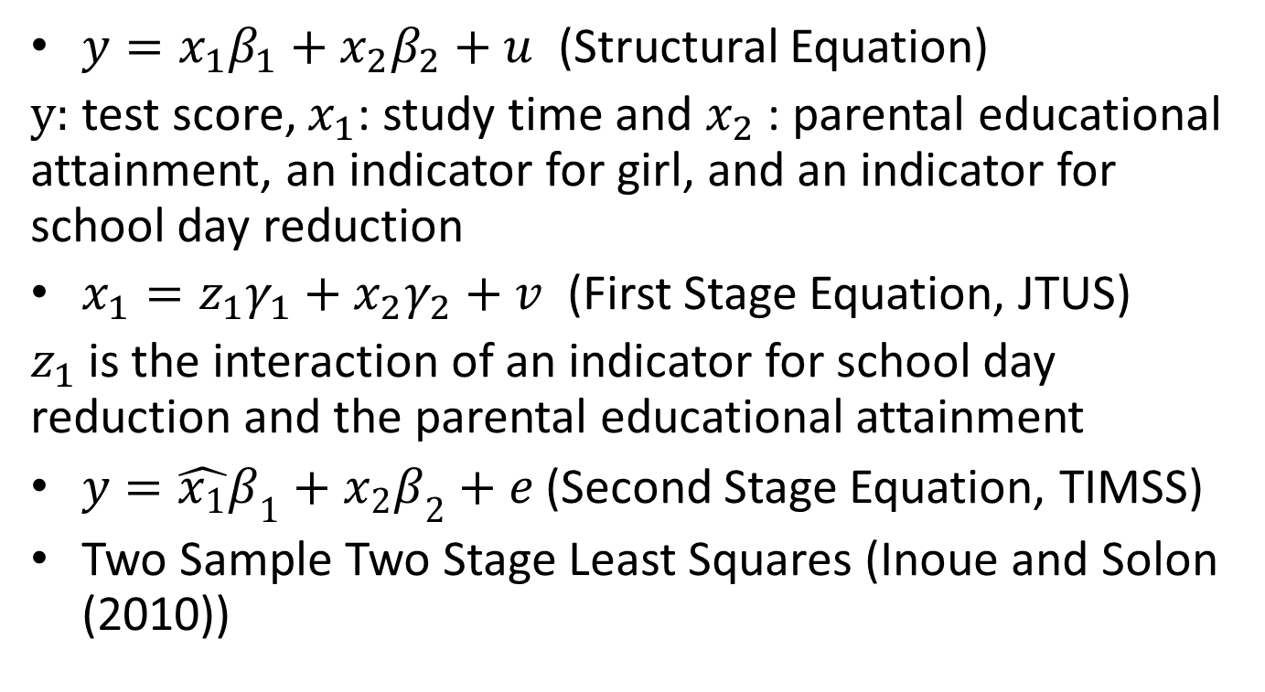
Local Average Treatment Effect of Study Time on Students’ Achievement
$y=x_{1}β_{1}+x_{2}β_{2}+u$ (Structural Equation)
$y:$ test score, $x_{1}$: study time and $x_{2}$ : parental educational attainment, an indicator for girl, and an indicator for school day reduction
$x_{1}=z_{1}γ_{1}+x_{2}γ_{2}+v$ (First Stage Equation, JTUS)
$z_{1}$ is the interaction of an indicator for school day reduction and the parental educational attainment
$y=\hat{x_{1}}β_{1}+x_{2}β_{2}+e$ (Second Stage Equation, TIMSS)
Two Sample Two Stage Least Squares (Inoue and Solon (2010))

Slide 25
The Effects of Study Time on Test Scores, Two Sample 2SLS Estimation
 | (1) | (2) | (3) | (4) | (5) | (6)
Sample | JTUS | TIMSS | TIMSS | PISA | PISA | PISA
Dependent Variable | Study Time | Mathematics Score | Science Score | Reading Score | Mathematics Score | Science Score
Study Time | - | 0.16 | 0.14 | 0.04 | 0.04 | 0.03
(in minutes per day) |  | (0.04,0.70) | (0.03,0.60) | (0.00,0.07) | (-0.00,0.07) | (-0.00, 0.07)
Parent Education | 7.38 | 2.17 | 2.21 | 0.55 | 0.56 | 0.68
 | (1.89) | (-2.38,3.81) | (-2.23,3.68) | (0.13,1.01) | (0.07,1.10) | (0.12,1.11)
Year 2001 | 22.65 | - | - | - | - | -
 | (7.33)
After 2002 | 12.55 | -4.98 | -4.62 | -0.87 | -0.80 | -0.69
 | (8.34) | (-13.64,-1.78) | (-12.56,-1.59) | (-1.36,-0.04) | (-1.37,0.16) | (-1.30,0.18)
(Parent Education - 12) | 1.61 | - | - | - | - | -
× 2001 | (3.07)
(Parent Education - 12) | 6.76 | - | - | - | - | -
× 2006 | (3.56)
Girl | 26.63 | -4.54 | -4.83 | 2.18 | -1.47 | -0.41
 | (6.27) | (-18.45,-1.13) | (-12.56,-1.59) | (1.26,3.12) | (-2.63,-0.36) | (-1.62,0.60)
Observations | 0.02 | 0.06 | 0.06 | 0.09 | 0.07 | 0.07
R-squared | 16,637 | 9,182 | 9,182 | 9,372 | 7,621 | 7,611

Slide 26
Conclusion
Making Saturdays as school holidays reduced study time and increased leisure time of children with less educated parents.
Children with better educated parents did not change study time in total.
Decreasing the intensity of compulsory education increases the socioeconomic gradient of study time and test scores.
Study time is a valuable input for test scores among disadvantaged students.
Compulsory education homogenizes socioeconomic outcomes by equating human capital investment across social classes.

